Slide 1


Mutual Friend Recommender
This presentation details our mutual friend recommender system. It leverages graph algorithms to enhance social connectivity.
Group Members:-
Rahil Kothari
Jitesh Sidhani
Harshit Sahani

Slide 2

Problem Statement
Increase Engagement
New Connections
Suggesting relevant new friends is crucial.
Social media aims to boost user engagement.
BFS Solution
We use Breadth-First Search (BFS) for this.
Existing users have direct friends. Identifying meaningful new connections remains a challenge for platforms. Our project addresses this using BFS to recommend relevant new connections.

Slide 3
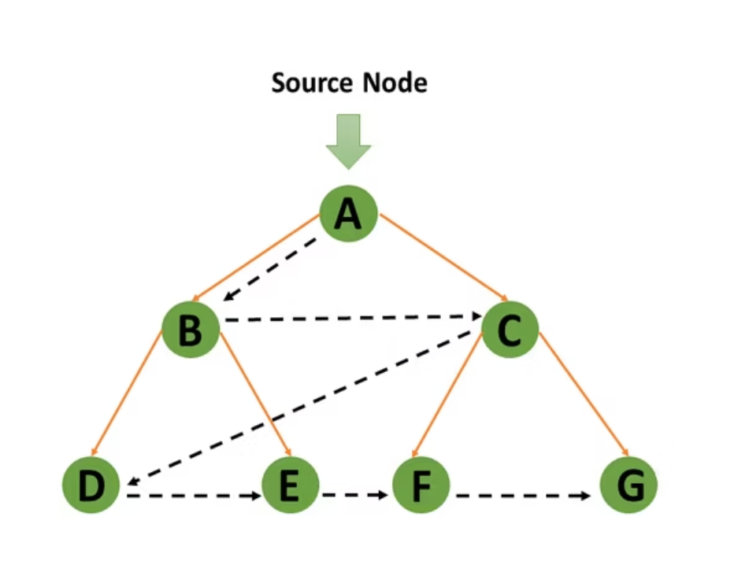
Graph Representation
The social network is modeled as a graph.
Nodes represent individual users.
Edges signify friendships between users.
This structure clearly shows connections.
First-degree connections :- These are direct friends.
Second-degree connections :- These are friends of friends.

Slide 4

Why BFS?
Layer-by-Layer Exploration
Quick Discovery
BFS quickly finds relevant suggestions. It prioritizes closely connected users.
BFS explores friends layer by layer, making it ideal for discovering mutual and second-degree connections.
DFS Contrast
DFS goes deep into one path first, which can skip nearby (2nd-degree) connections important for friend suggestions.

Slide 5
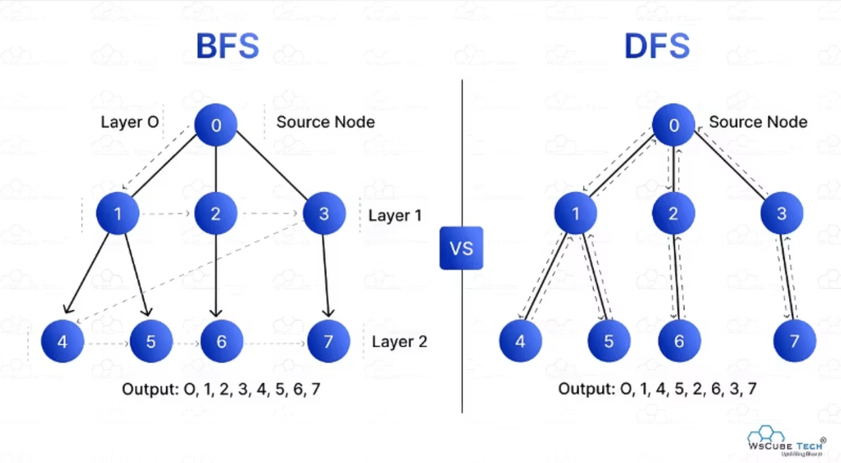
BFS vs DFS

Slide 6
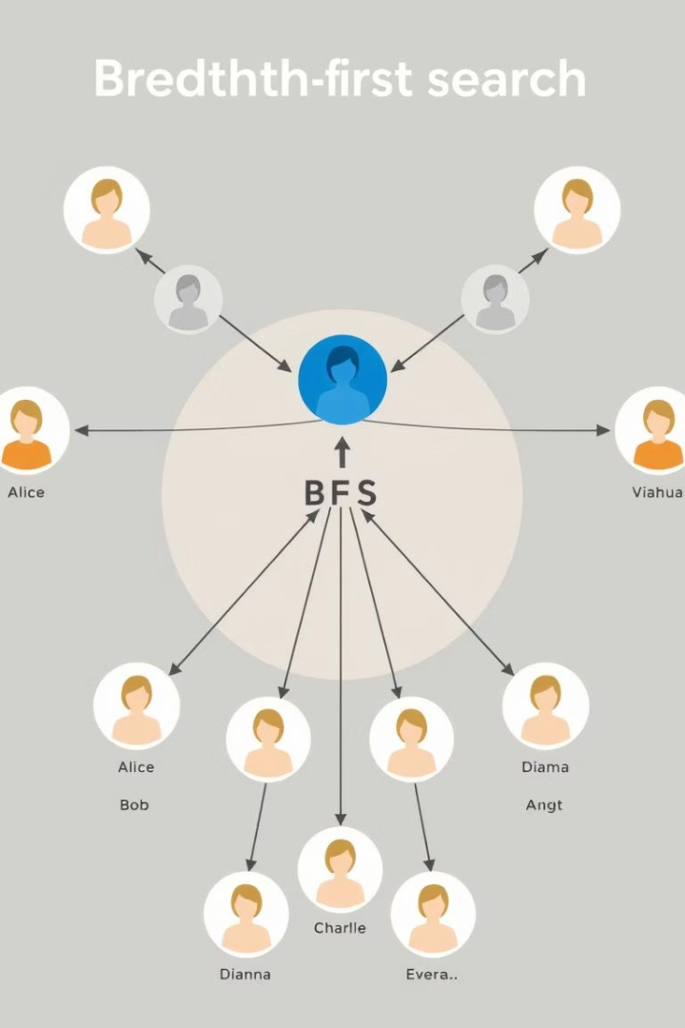




BFS Algorithm Logic
Start from User
Begin the search from a specific user, for example, 'A'. This user is the origin of the search.
Use a Queue
A queue helps explore connections level by level. This ensures breadth-first traversal.
Track Visited Users
Keep a record of all visited users. This prevents infinite loops and redundant checks.
Suggest Level 2 Users
Recommend users at level two if they are not already direct friends. These are mutual connections.

Slide 7
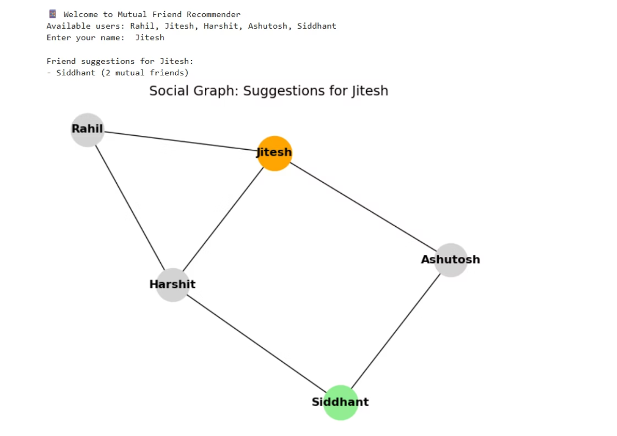

Example Output :-

Slide 8
Benefits and Limitations
Benefits
Limitations
Simple and efficient algorithm.
Ignores user interests or activities.
Works well for unweighted social graphs.
May suggest irrelevant friends in dense networks.
Easy to implement and scalable.
Doesn't consider edge weights or relationship strength.
While BFS offers clear advantages in friend recommendation, it also has limitations. Future enhancements could address these to provide more tailored suggestions. We strive for a comprehensive solution.

Slide 9

Conclusion
Effective Proximity
BFS efficiently suggests friends based on social proximity.
Platform Utility
It is highly useful for platforms like Facebook or LinkedIn.
Future Enhancements
It can be improved with mutual friend counts and relationship weights.
BFS is a solid foundation for friend recommendations. Continuous development will refine its accuracy and relevance. We are committed to optimizing social connections.

Slide 10

Any Questions?

